Slide 1
Award Presentation Collaborative Initiative for Paediatric HIV Education and Research (CIPHER) Grant and Fellowship Programmes
Linda-Gail Bekker, South Africa

Slide 2
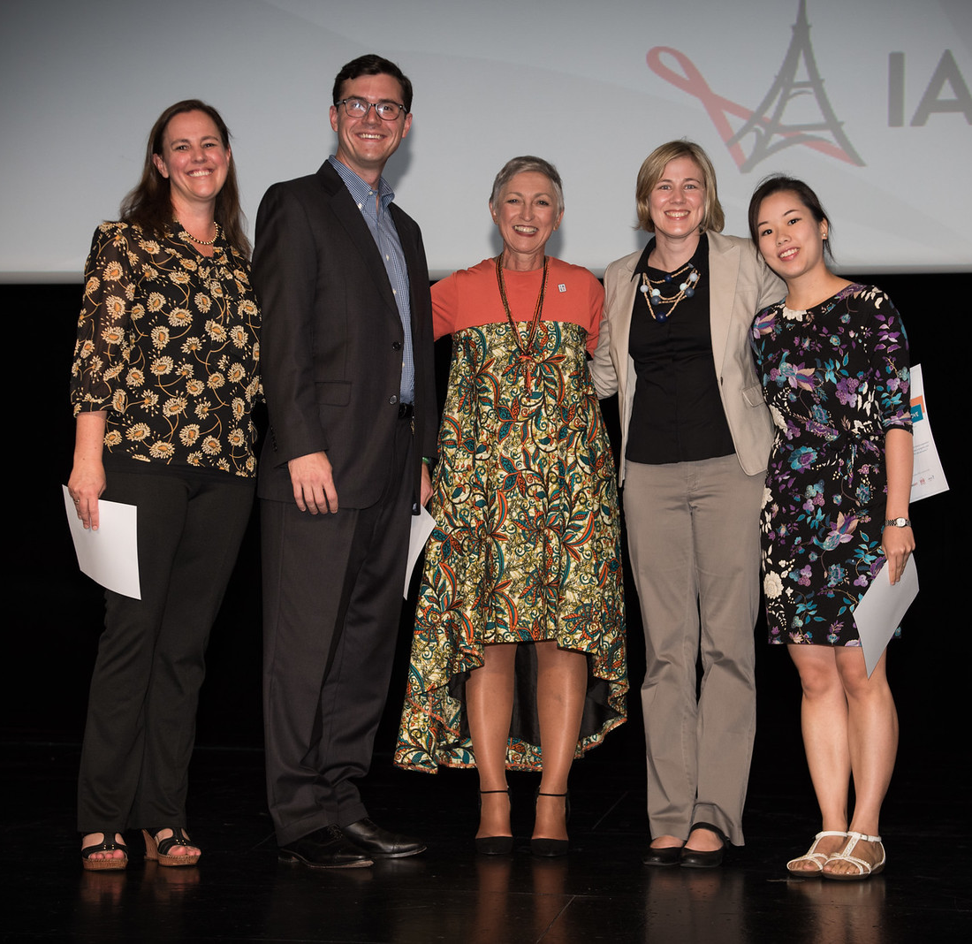
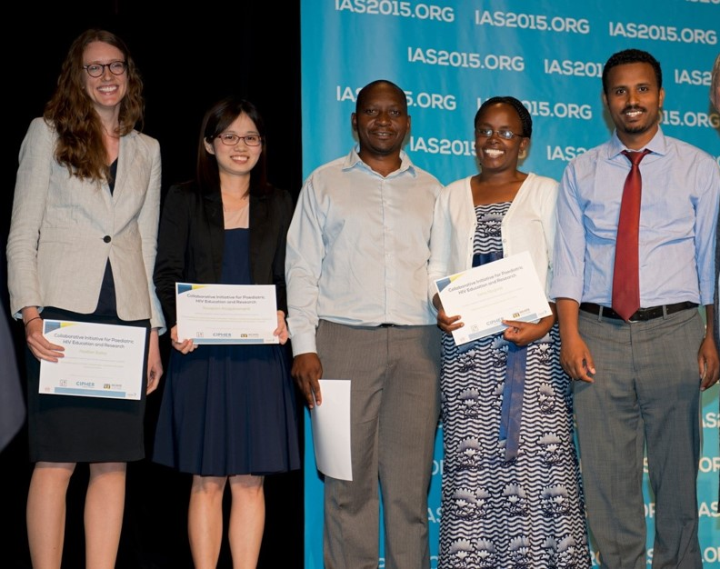
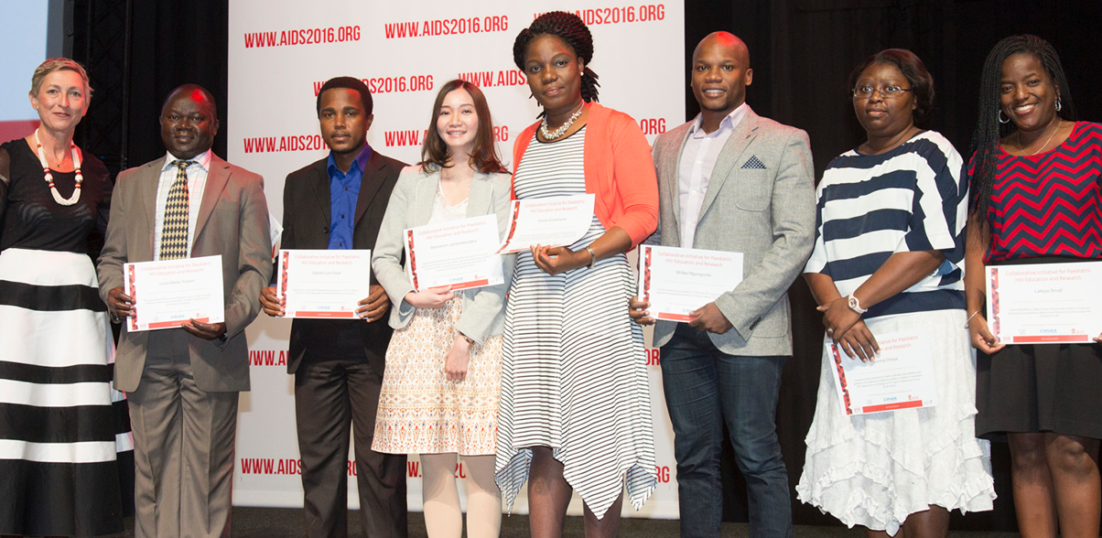
CIPHER Research Grant Programme
Objectives
Development of early-stage investigators
Research gaps in paediatric and adolescent HIV
Resource-limited settings
Grants
80% funds awarded to applicants from LMICs
Up to US$ 150,000 for two years
http://www.iasociety.org/cipher

Slide 3
2018 CIPHER grantee Alain Amstutz Lesotho, Swiss Tropical and Public Health Institute
GET ON IT (“GETting tOwards Ninety In Teens”): A two-part research project with one cluster-randomized controlled trial assessing targeted interventions to reach the UNAIDS 90-90-90 targets among HIV-positive adolescents and young adults in rural Lesotho, Southern Africa

Slide 4
2018 CIPHER grantee Millicent Atujuna South Africa, Desmond Tutu HIV Foundation
The impact of poverty on Anti-retroviral therapy adherence and retention in Care of South Africa’s Generation of adolescents living with HIV: Implications for strategies and intervention development

Slide 5
2018 CIPHER grantee Sirinya Teeraananchai Thailand, the HIV Netherlands Australia Thailand Research Collaboration (HIV-NAT)
Evaluation of service delivery to improve the HIV treatment cascade among HIV-infected youth in Thailand

Slide 6
2018 CIPHER grantee Elona Toska South Africa, University of Cape Town
Improving retention in PMTCT and ART care for HIV-infected adolescent mothers and their children in Southern Africa.
Helping Empower Youth Brought up Living in Adversity and their Babies and Young Children

Slide 7
Postdoctoral Research Fellow HIV-Exposed Uninfected child health outcomes Barbara Burmen

Slide 8
CIPHER is pleased to launch a new round of the Research Grant Programme
Early-stage investigators: this could be your chance to be principal investigator on a sizeable grant for the first time
Special focus on operational science in paediatric HIV
Applications open 1 October 2018
http://www.iasociety.org/cipher

Slide 9
CIPHER is pleased to launch a new round of the Growing the Leaders of Tomorrow Fellowship Programme
Mentors: have you identified a young investigator with immense potential?
Junior investigators: are you the next young leader in paediatric and adolescent HIV clinical science?
Paediatric and adolescent HIV clinical research in Sub-Saharan Africa
Mentored Fellowship of up to US$ 70,000 for two years
Applications open 12 November 2018
http://www.iasociety.org/cipher

